Slide 1
G U I Programming and Basic Controls

Slide 2
Contrasting Windows and Console Applications
Console applications
Each line in Main( ) executed sequentially – then the program halts
Windows applications
Once launched, sits and waits for an event
Sits in a process loop
Event: notification from operating system that an action, such as the user clicking the mouse or pressing a key, has occurred
Windows applications also look different from console applications

Slide 3
Event-Driven Programming
Event-driven programming is very different from most programming seen up until now
So far, programs have consisted of a list of statements executed in order
When that order changed, whether or not to perform certain actions (such as repeat statements in a loop, branch to another statement, or invoke a method) was controlled by the logic of the program
In event-driven programming, the program itself no longer determines the order in which things can happen
Instead, the events determine the order
Notes:
3

Slide 4
Event-Driven Programming
In an event-driven program, the next thing that happens depends on the next event
In particular, methods are defined that will never be explicitly invoked in any program
Instead, methods are invoked automatically when an event signals that the method needs to be called
Notes:
4

Slide 5
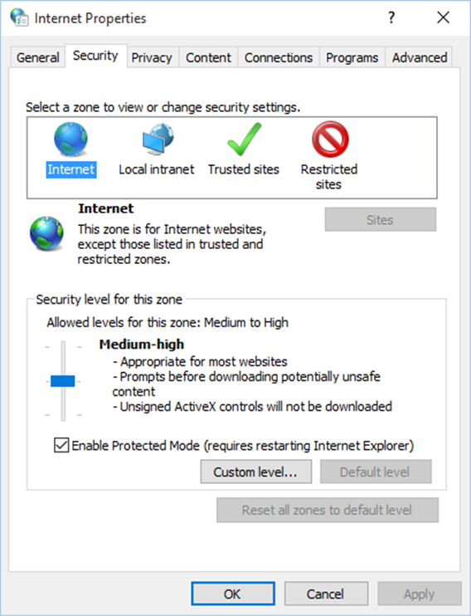
Graphical User Interfaces (1 of 3)
Many Java applications use a graphical user interface or G U I (pronounced “gooey”).
A G U I is a graphical window or windows that provide interaction with the user.
Notes:
The dialog box has general, security, privacy, content, connections, programs, and advanced, tabs presented above. The tab security is selected. A pane presents zones, with a text select a zone to view or change security settings. The internet option is selected.

Slide 6
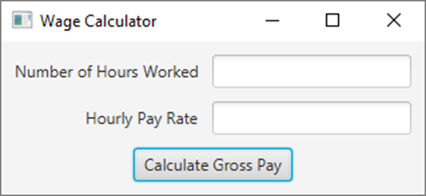
Graphical User Interfaces (2 of 3)
A window in a G U I commonly consists of several controls that present data to the user and/or allow interaction with the application.
Some of the common G U I controls are buttons, labels, text fields, check boxes, and radio buttons, etc.,.

Slide 7
Graphical User Interfaces (3 of 3)
Programs that operate in a G U I environment must be event-driven.
An event is an action that takes place within a program, such as the clicking of a button.
Part of writing a G U I application is creating event listeners.
An event listener is a method that automatically executes when a specific event occurs.

Slide 8
Graphical User Interfaces (3 of 3)
So we need to import:
java.awt.* : the abstract window toolkit - the first generation Java API
javax.swing.* : the "swing" extension toolkit - provides additional functionality on top of AWT
Swing is a Java package used to create GUIs
The Java AWT (Abstract Window Toolkit) package is the original Java package for doing GUIs
The Swing package is an improved version of the AWT
However, it does not completely replace the AWT
Some AWT classes are replaced by Swing classes, but other AWT classes are needed when using Swing
Notes:
8

Slide 9
Containers and Components
A Swing GUI consists of two key types of items: Components and Containers although the distinction is often blurred because every Container is a Component
Component -- a visual control (e.g. button)
Container - holds and arranges groups of components
All Swing GUIs have at least one “top level” container, the most common of which is the JFrame

Slide 10
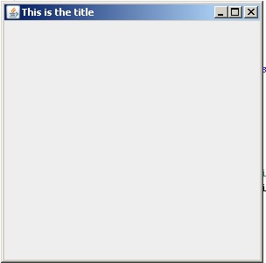
A Simple Window
A simple window can consist of an object of the JFrame class
A JFrame object includes a border and the usual three buttons for minimizing, changing the size of, and closing the window
The JFrame class is found in the javax.swing package
This code snippet creates a JFrame and initializes its attributes
JFrame frame = new JFrame( "This is the title");
// or frame.setTitle("This is the title");
// set the frame's size and position
frame.setSize( 300, 300);
frame.setLocation( 200, 200);
//make frame visible
frame.setVisible(true);
// close application when window closed
frame.setDefaultCloseOperation(JFrame.EXIT_ON_CLOSE);
The window’s size is measured in pixels. A pixel is one of the small dots that make up a screen display; the resolution of your monitor is measured in pixels. For example, if your monitor’s resolution is 1024 by 768, that means the width of your screen is 1024 pixels, and the height of your screen is 768 pixels.
Notes:
Frame.setResizable(false) //prevent frame from frame being resizable
ImageIcon image = new ImageIcon("logo.png"); //create an ImageIcon
frame.setIconImage(image.getImage()); //change icon of frame
frame.getContentPane().setBackground(new Color(0x123456)); //change color of background
10

Slide 11
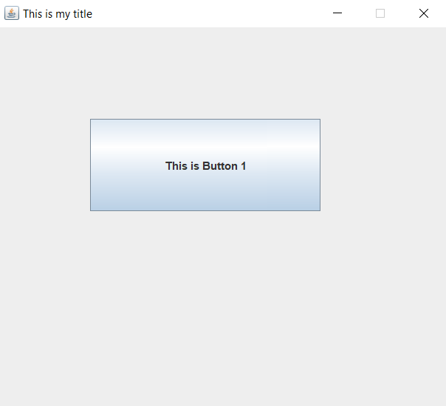
JButton
One of the most common components of a GUI is a button that is pushed to perform an action.
A button object is created from the class JButton and can be added to a JFrame
The argument to the JButton constructor is the string that appears on the button when it is displayed.
This code snippet creates a JButton and adds it to the frame.
// create and add a button to the frame
JButton button1 = new JButton(“This is Button 1");
button1.setBounds(100, 100, 250, 100);
frame.add( button1 );

Slide 12
Nothing Happens
If you run the previous Button, you’ll find that nothing happens when you push the button.
What do we need to do to make “something happen” when the button is pushed?
1. we need a method to do the "something" when the button is pushed
2. we need to know when the button is pushed
a. first we need to tell the button we want to be told when it's pushed b. the button needs a way to call our method when it's pushed
All of this is implemented using event-driven programming

Slide 13
Events
Event-driven programming is a programming style that uses a signal-and-response approach to programming
An event is an object that acts as a signal from the event source to another object known as a listener
The sending of an event is called firing the event
The object that fires the event is often a GUI component, such as a button that has been clicked
Notes:
13

Slide 14
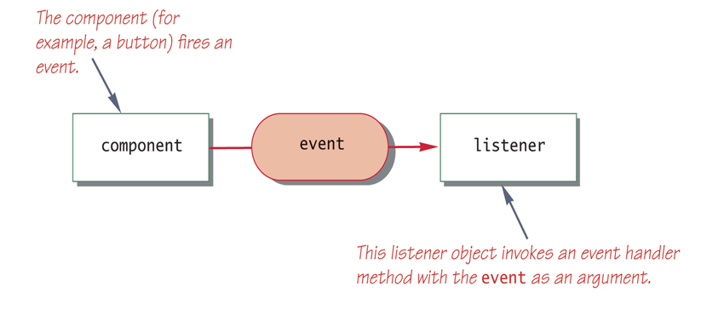
Listeners
A listener object performs some action in response to the event
A given component may have any number of listeners
Each listener may respond to a different kind of event, or multiple listeners might may respond to the same events
Notes:
14

Slide 15
Event Handlers
A listener object has methods that specify what will happen when events of various kinds are received by it
These methods are called event handlers
Notes:
15

Slide 16
Events and Listener Interfaces
In Java, every event type has a matching listener interface.
For MouseEvents implement the MouseListener interface
For WindowEvents implement the WindowListener interface
Etc., etc. etc.
Some interfaces (e.g. MouseListener) have multiple methods because the event itself can happen in different ways (mouse pressed, mouse released, mouseMoved, etc)
JButtons fire off ActionEvents, so in our example, we need to implement the ActionListener interface

Slide 17
ActionListener Interface
The ActionListener interface consists of a single method:
public void actionPerformed(ActionEvent event)
This is the method that we want to be called when the button is pushed.
This code snippet is a simple implementation of actionPerformed that changes the button’s text
public void actionPerformed(ActionEvent ae)
{
button1.setText("I've been pushed");
}

Slide 18
Registering as a Listener
Now that we’ve written the actionPerformed method, we need to tell the button to call it when the button is pushed. To do that, we need to register our object as a listener for the button. To do so we call the button’s addActionListener method
button1.addActionListener(this);

Slide 19
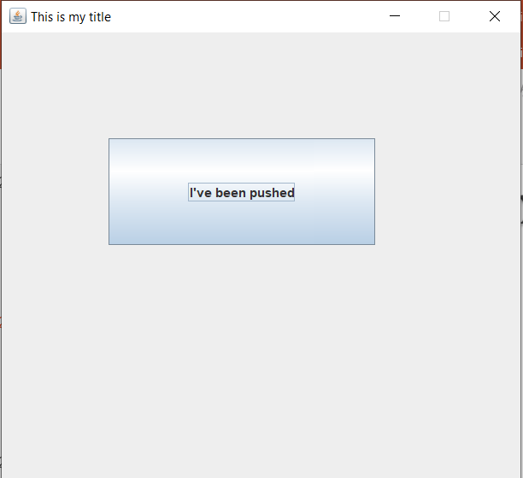
Pushing the Button
Before
After

Slide 20
JPanel
A GUI is often organized in a hierarchical fashion, with containers called panels inside other containers
A panel is an object of the JPanel class that serves as a simple container
It is used to group smaller objects into a larger component (the panel)
One of the main functions of a JPanel object is to subdivide a JFrame or other container
Notes:
20

Slide 21
Other Common Components
JLabel – an uneditable line of text
JTextField – a single line of editable text
JTextArea – a multi-line area of editable text
JList – a list for item selection
JCheckBox – a single on/off choice
Etc.,

Slide 22
Objects in a Typical GUI
Almost every GUI built using Swing container classes will be made up of three kinds of objects:
The container itself, probably a panel or window-like object
The components added to the container such as labels, buttons, and panels
A layout manager to position the components inside the container
Notes:
22

Slide 23
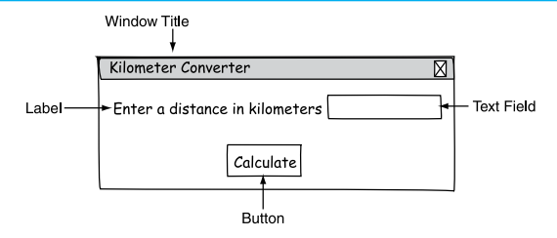
Demo
To demonstrate what we learned so far, we will build a simple GUI application: The Kilometer Converter.
This application will present a window in which the user will be able to enter a distance in kilometers, and then click a button to see that distance converted to miles.
The conversion formula is as follows: Miles = Kilometers X 0.6214

Slide 24
How are components arranged
Our example GUI has just one component, the button. How do put more than one component into a JFrame?
By default, a JFrame has 5 regions to which components can be added. These regions are defined by the BorderLayout manager.

Slide 25
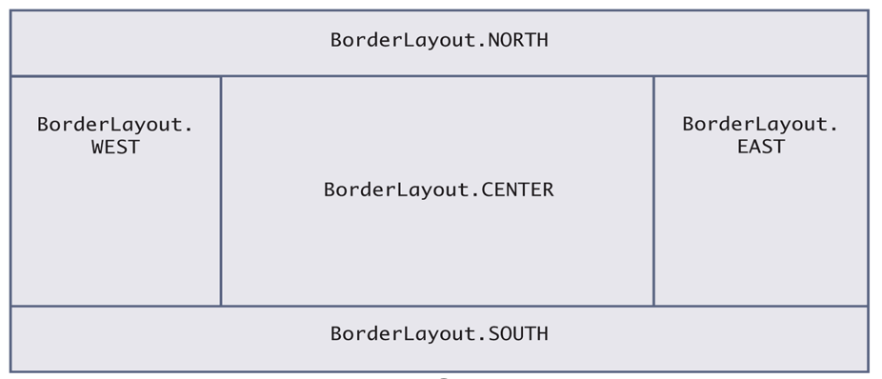
BorderLayout
BorderLayout is the default layout for a JFrame. Other layouts (FlowLayout,GridLayout)
When we add a component to a JFrame, we specify which region you want the component placed. Therefore components can be added in any order.

Slide 26
Using the BorderLayout
This code snippet places a JButton in the WEST region and a JLabel in the NORTH region.
// create a button and add "this" object as a listener
JButton button1 = new JButton("This is Button 1");
button1.addActionListener(this);
frame.add( BorderLayout.WEST, button1 );
// create and add the label
JLabel label1 = new JLabel("I am label 1");
frame.add( BorderLayout.NORTH, label1);

Slide 27
Another Button
Let’s add a 2nd button to our GUI that will change the label’s text in a different way. It means a 2nd event?
How do we get ActionEvents from two different buttons when each button does something different?

Slide 28
Icons
An icon is a small picture
Components such as JButtons and JLabels may be decorated with icons that are created from .jpg, .gif or .png files
This code snippet creates an ImageIcon object then uses it to decorate JLabels
ImageIcon icon = new ImageIcon(“ant.jpg");
JLabel label1 = new JLabel(icon);
JLabel label2 = new JLabel("Image & Text", icon, JLabel.CENTER);

